Slide 1
AI-201 LAB FINAL PROJECT
INSTRUCTOR: MR. AAMIR MAAROFI
Student Score Analyzer & Grade Predictor
TEAM MEMBERS:
Batool Binte Fazal (2024140)
Rida Syed (2024540)
AI-POWERED ACADEMIC PERFORMANCE ANALYSIS SYSTEM

Slide 2


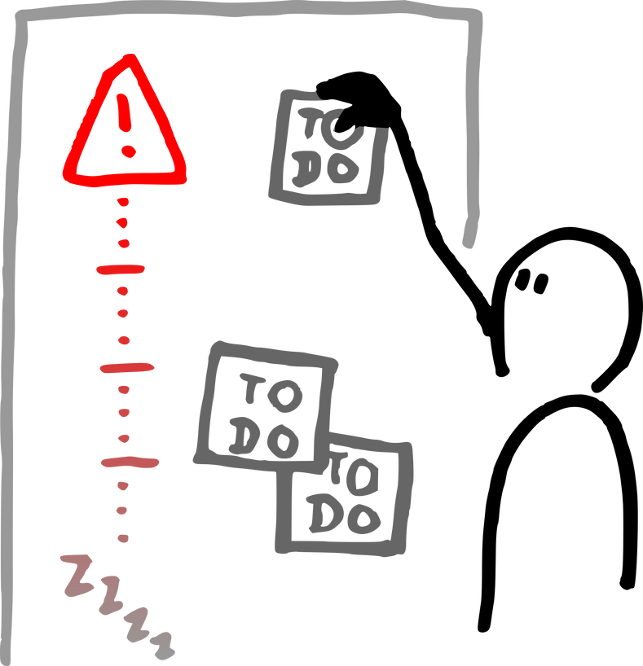
Introduction
Project Overview
Problem
Solution
Dataset
  Early identification of at-risk students
  Predicting performance before exams
  Manual dataset analysis is time-consuming
  Predicts scores with high accuracy
  Identifies at-risk students (Low/Medium/High risk)
  Analyzes study time, parental education, test prep impact
  One-click predictions & insights
  Source: Kaggle - Students Performance in Exams
  Size: ~1000 records
  Demographics: gender, race/ethnicity, parental education
2

Slide 3
CONCEPTS USED
System Architecture and OOP Design
6 CORE CLASSES IMPLEMENTATION:
1. DataCleaner
  Removes null values and duplicates
  Encodes categorical variables using LabelEncoder
  Validates required columns
  Exception handling for invalid datasets
2. FeatureEngineer (NumPy)
  Performance Index:
PI = 0.5×math + 0.3×reading + 0.2×writing
  Z-score outlier detection
  Percentile ranking using np.percentile()
3. ModelTrainer
  Trains 3 ML models with StandardScaler pipeline
  Train/test split (80/20)
  Model evaluation with multiple metrics
4. Visualizer
  Generates 4 Matplotlib plots with advanced styling
  3D scatter using Axes3D, gradient coloring
  Statistical overlays and correlation analysis
5. Predictor
  Real-time predictions (score, grade, pass/fail, risk level)
  Grade conversion (A/B/C/D/F)
6. ModelPersistence
  Saves/loads models using Pickle
  Persistent scaler and feature names
3

Slide 4
LIBRARIES USED
MACHINE LEARNING MODELS & ADVANCED FEATURES
Three ML Models:
Advanced NumPy Operations:
Data Visualization using Matplotlib:
Linear Regression:
  Score prediction (0-100)
  Metrics: RMSE, R²
Logistic Regression:
  Pass/Fail classification
  Accuracy
K-Nearest Neighbors:
  Risk assessment
  KNeighborsClassifier (k=5)
  Z-score: identifies outliers where |z| > 2
  Percentile ranking: compares student to entire cohort
  Polynomial interactions: study_time × parental_education
  Weighted performance index using NumPy arrays
  Histogram with gradient coloring
  Bar chart with error bars and statistical overlays
  Donut pie chart for demographics
  3D scatter plot (Study Time × Parental Education × Score) with correlation statistics
4

Slide 5
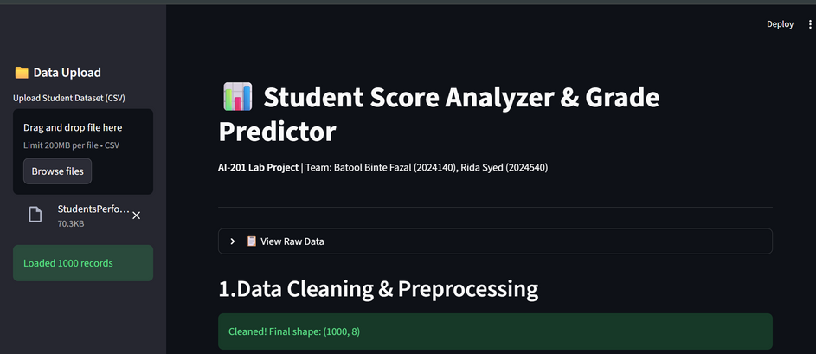
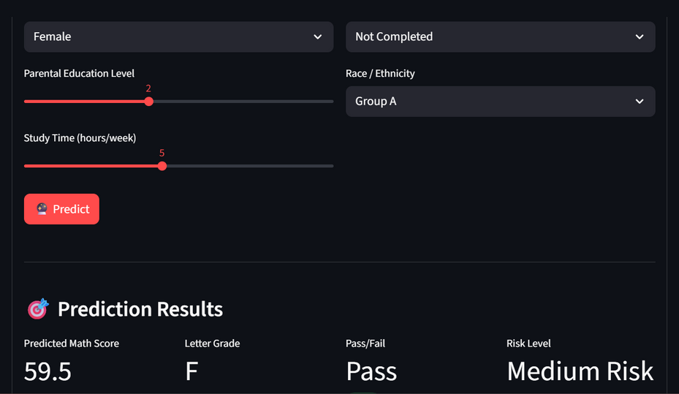
TECHNOLOGIES USED
Technology Stack and Results
Core Libraries:
  NumPy: Advanced numerical computations, vectorized operations
  Pandas: Data analysis, GroupBy operations, Q&A style analytics
  Matplotlib: 4 visualizations including 3D scatter (mpl_toolkits.mplot3d)
  Scikit-learn: ML models, StandardScaler, train_test_split
  Streamlit: Interactive web dashboard
  Pickle: Model persistence and reloading
5

Slide 6
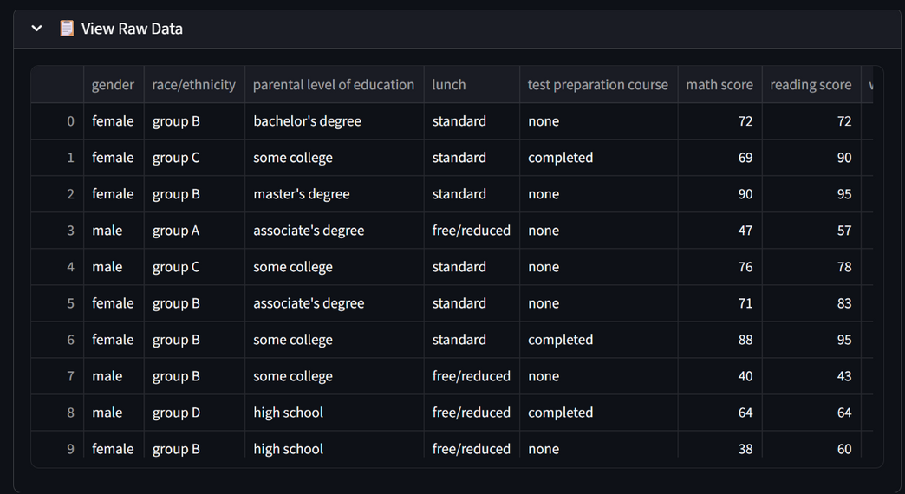
Project Summary
Key features
Data Loaded in Streamlit Web App
  Complete ML Pipeline: Data cleaning → Feature engineering → Training → Prediction
  Advanced Analytics: Percentile ranking, z-score outliers, polynomial features
  Interactive Dashboard: Streamlit web app with CSV upload & real-time predictions
  Production Ready: Exception handling, model save/load, scalable OOP design
Real-World Impact:
This system enables educational institutions to make data-driven decisions, identify struggling students early, and provide timely interventions - transforming raw academic data into actionable insights that improve student outcomes.
6

Slide 7
AI-201 LAB FINAL PROJECT
INSTRUCTOR: MR. AAMIR MAAROFI
Thankyou!
TEAM MEMBERS:
Batool Binte Fazal (2024140)
Rida Syed (2024540)

